Slide 1





Boxes-based Representation and Data Sharing of Road Surface Friction for Connected and Autonomous Vehicles (CAVs)
Liming Gao ¹ , Craig Beal², Wushuang Bai ¹,
Satya Prasad Maddipatla¹ , Cindy Chen³, Kshitij Jerath³,
Hossein Haeri³, Lorina Sinanaj³, Sean Brennan¹
¹The Pennsylvania State University
²Bucknell University
³University of Massachusetts Lowell
2022
Notes:
Hello, Ladies and Gentlemen.
It’s my great honor to share our work with you.
My name is Juliette, coming from Penn State University. The other co-authors are XXX Dr. Beal, and Dr. Brennan

Slide 2

The unforeseen hazardous road surface friction conditions (snow, ice, rain, etc.) have a significant negative impact on vehicle safety and mobility.
https://www.youtube.com/watch?v=QyI4mjuGsQE
Notes:
Now, let’s start by the motivation.
This paper is motivated by the fact that unforeseen friction change has a significant negative impact on vehicle safety and mobility because vehicles are highly likely to lose control unexpectedly when encountering unforeseen hazardous road friction conditions. For example, in this video, the driver didn’t noticed the upcoming icy bridge which has a sudden decease of road friction and operate the vehicle proactively . As a result, the vehicle lost of control and departed from the lane.

Slide 3
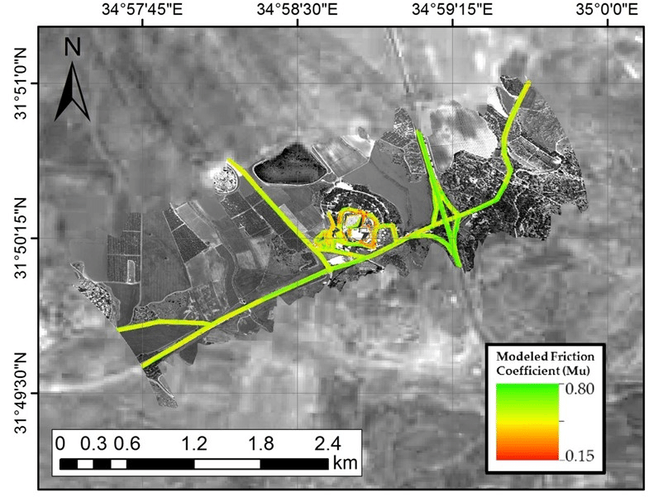

In impacting vehicle stability and safety, few data are as important as maps of the friction between tires and the road surface.
https://snowbrains.com/know-drive-winter-take-quiz/
N. Carmon, and E. Ben-Dor, "Mapping Asphaltic Roads’ Skid Resistance Using Imaging Spectroscopy," Remote Sensing, vol. 10, no. 3, p. 430
S. Chen, T. U. Saeed, and S. Labi, “Impact of road-surface condition on rural highway safety: A multivariate random parameters negative binomial approach,” Anal. Methods Accid. Res., vol. 16, pp. 75–89, 2017, doi: 10.1016/j.amar.2017.09.001.
Notes:
In impacting vehicle stability and safety, few data are as important as maps of road surface conditions and the friction between tires and the road surface. Some research has been conducted in this area , yet actionable road-friction maps are not yet widely available. Research has proved that prior estimation of friction allows significant improvements in vehicle chassis control systems [7]. Specifically, a vehicle can proactively plan appropriate paths and velocities with the preview of friction distribution, particularly where and how friction ahead of a vehicle may be suddenly decreasing. In addition, the availability of friction preview could enhance the performance and reliability of driver-assist systems such as stability control, adaptive cruise control, and electronic braking. The potential benefit of a friction map to mitigate the impact of road surface conditions on traffic safety and mobility via providing a preview is obvious, but mapping road friction is a challenging problem. Thus, an efficient and cost-effective road surface friction mapping and data-sharing methodology are needed.

Slide 4
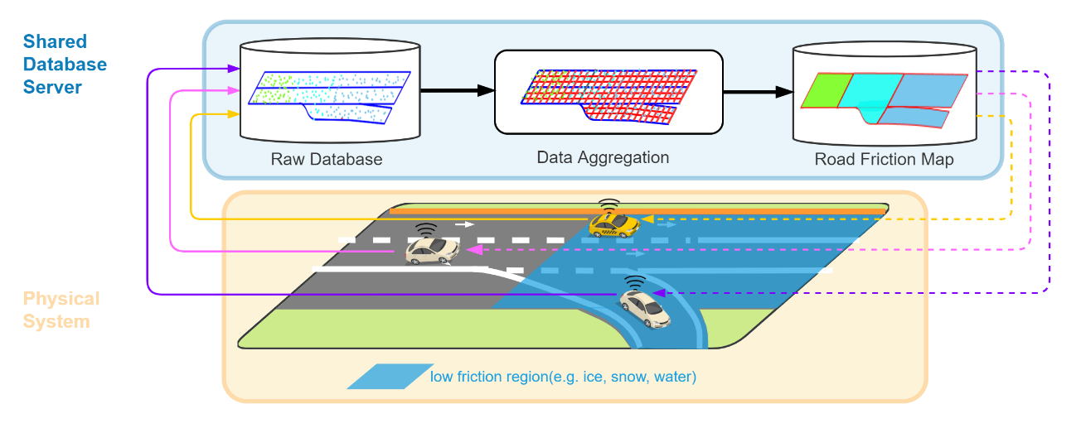
This paper presents a road friction map generation strategy by aggerating the measured road-tire friction coefficients from a fleet of CAVs.
Raw Friction Data
Figure: A road friction map generation strategy by aggerating the measured road-tire friction coefficients along the individual trajectories of CAVs through a shared roadside database.
Notes:
Based on the introduction of motivation and background, this work presents a road friction map generation strategy by aggerating the measured road-tire friction coefficients from a fleet of CAVs. This Figure illustrates the data flow framework of this strategy. In the framework, the estimated raw road friction data streaming from a fleet of vehicles driving on a road segment is shared with a database; then, the raw data is aggregated into a friction map and shared back to vehicles for appropriate driving planning. A naive approach is to finely grid the road surface in the data aggregation step at levels similar to the fidelity of tire position accuracy and contact patch size, generally on the order of 10cm; however, if one wishes to maintain this resolution then such databases, even for modest-sized roads, rapidly become prohibitively large. This insight motivated efforts in this paper such that the friction map can be represented compactly by rectangular boxes defined by a pair of corner coordinates in space and a friction value within the box.

Slide 5
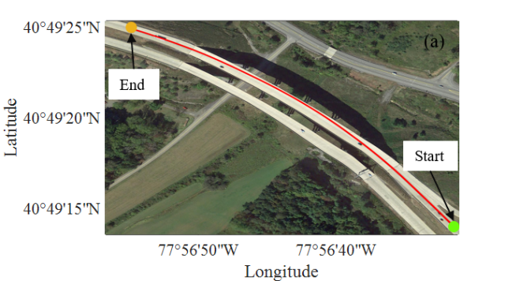
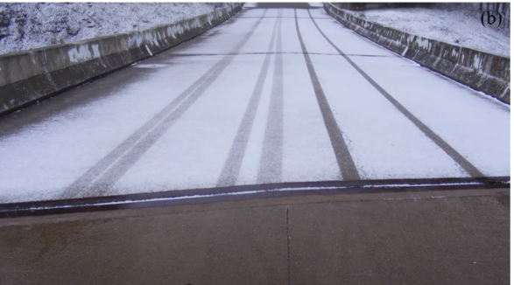
A highway bridge segment where friction changes in space is selected as a sample to demonstrate the friction map generation process.
Snow ruts
Friction decrease
Sudden friction decrease with snow ruts
Notes:
In this work, a highway segment where friction changes in space, particularly over a bridge, is selected as a sample to demonstrate the friction map generation process. The geolocation and geometry of the road segment are selected from the Interstate-99 interstate highway, outside State College, PA, USA, shown in Figure (a). It is a 496m double-lane highway segment with a 3.8 m lane width.
Figure (b) shows a typical actual road friction distribution pattern with the occurrence of ice and as well real-world photographs on bridges showing lateral snow ruts. A bridge is exposed to cold air more than a normal road surface with a solid roadbed. As a result, when it snows and the temperature drops, a bridge tends to cool and accumulate snow and ice much faster than the surrounding pavement. After a while, the bridge is completely covered in snow, while the adjacent roads are completely snow-free [21]. The transition from the clear road to snow takes place in mere centimeters. The most dangerous threat of this road condition is the unforeseenness, which catches drivers off guard when they are driving at full speed as the rest of the road is dry or just a little wet. Consequently, vehicles with high speed are highly likely to lose control unexpectedly when encountering the bridge with this unforeseen sudden decrease in friction. Moreover, snow ruts occur along the wheel paths when vehicles drive through the snowy bridge. Rutting is a transverse pavement surface condition characteristics, which has a different friction feature with the adjacent road [18], [22]. Consequently, lane changing on the roads with snow ruts presents a potential threat to vehicle stability and control. Thus, a road surface map that can provide a preview of this scenario could enable the human drivers or autonomous vehicles to plan appropriate driving strategies proactively to avoid loss of control on this type of road segment.

Slide 6
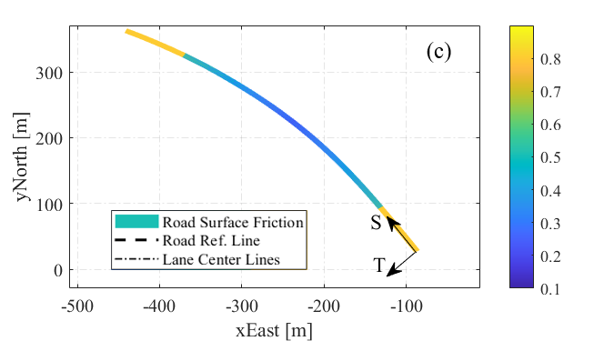
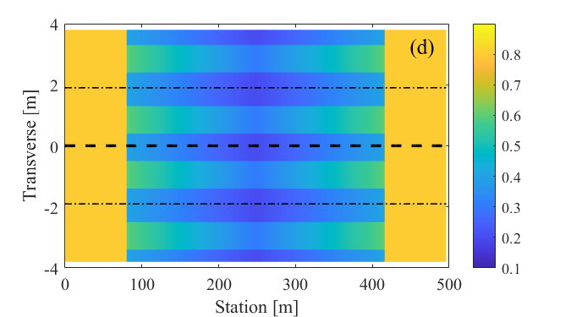
Without loss of the generality, to represent the snowy bridge and snow ruts, we synthetically generate a friction distribution numerically as the “true” road surface condition in this work.
The numerical representation of the road surface friction pattern in east-north-up (ENU) cartesian coordinates and station-transverse-height (STH) curvilinear coordinates. The color bar indicates the friction coefficient values.
Notes:
Without loss of the generality, to represent the snowy bridge and snow ruts, we synthetically generate a friction distribution numerically as the “true” road surface condition in this work. This ground-truth data is shown in Figure 2 (c) and (d). To further align the data in directions that are likely similar in friction, the location of the road segment is first converted from latitude-longitude-altitude (LLA) geographic coordinates into the east-north-up (ENU) cartesian coordinates. Next, to align the data with the local roadway directions, the ENU coordinates are converted into station-transverse-height (STH) curvilinear coordinates. In the curvilinear STH coordinates system, the station is the distance traveled along the road segment reference line and the transverse is orthogonal offset from the reference line. The definition of STH is detailed further in section 3.1. This process ensures that the geometric length of road cells and travel distance are preserved.

Slide 7
Friction coefficient data acquisition from a fleet of connected vehicles.
Raw Friction Data
Notes:
To XX, the first step is Friction coefficient data acquisition from a fleet of connected vehicles

Slide 8

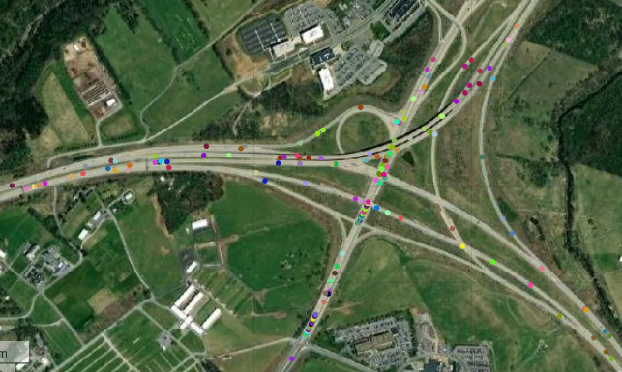
The measured data from each vehicle including the friction coefficient and the corresponding road-tire contact coordinates are pushed into a “raw data” database.
Shared Database
~10 million raw friction measurement data points
100Hz
30 minutes
1038 vehicles
Notes:
Even within this very limited time range and section of the road, the simulation produces about 10 million raw friction measurement data points, which take up 2.7GB of database storage space. The challenge to generate the friction map through the aggregation of such large-size measurement data is addressed in the next section.

Slide 9
Aggregate the measured road-tire friction coefficients data based on static road surface grids.
Raw Friction Data
Notes:
The goal of this study is to generate a road friction map by aggregating the measured road-tire friction coefficients along the individual trajectories of CAVs

Slide 10
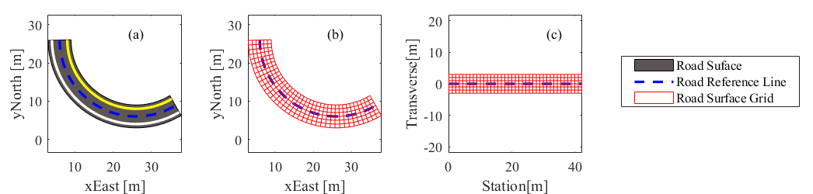
The road surface is tiled into regular grids and coordinate system of the grids is carefully chosen as it plays an essential role in data aggregation.
Figure: Grid-based road surface representation example. (a) a true road sample, (b) curved road grid in EN coordinates, (c) uncurved road grid in ST coordinates.
Notes:
To present the process, this section begins by introducing the grid-based road surface representation. This section then details the method to aggregate the raw friction data based on the road surface grid.
3.1 Grid-based road surface representation
Before any friction data aggregation steps, the local coordinate system of the grid is carefully chosen as it plays an essential role in defining data similarity and the success of the data aggregation process. The curved regular grid is a common way to describe the road surface data in high spatial resolution [24]. As illustrated in Figure 3, a road surface space as shown in Figure 3(a) can be divided into curved grid structures based on the road reference line which is generally the curved road centerline. Longitudinal cuts are parallel with the reference line, and the transverse cuts are orthogonal to the road reference line. The curved regular grid can be placed in an East-North(EN) Cartesian coordinate shown in Figure 3(b). Based on the grid, any road surface data, e.g., elevation and friction coefficients, is given in U-direction orthogonal to the E/N-plane. In this way, a microscopic view of the road surface can be described in a 3-dimensional(3D) data structure.
But vehicle friction data typically exhibit similarities in the travel or lateral directions. To enforce this similarity, the grid was next placed in the curvilinear station-transverse (ST) coordinate shown in Figure 3(c). ST is a right-handed coordinates system. The station direction follows the tangent of the road reference line and magnitude is the distance traveled along the road reference line from the beginning of the reference line. The transverse direction is orthogonal to the direction of station S and the magnitude is the offset distance from the reference line. Road surface data can be given in height (H)-direction orthogonal to the ST-plane. Using STH coordinates system, the road surface map can be represented with the uncurved grids and associated height values. Under STH frame, some frequently used mathematical calculations, such as distance, projection, and transformation, can be highly simplified. It is also interesting to note that in STH coordinates each grid cell can be regarded as an image pixel, and thereby the road map can be represented through an image. Consequently, common digital image processing algorithms and hardware (GPUs, for example) can be used for road surface data processing.

Slide 11
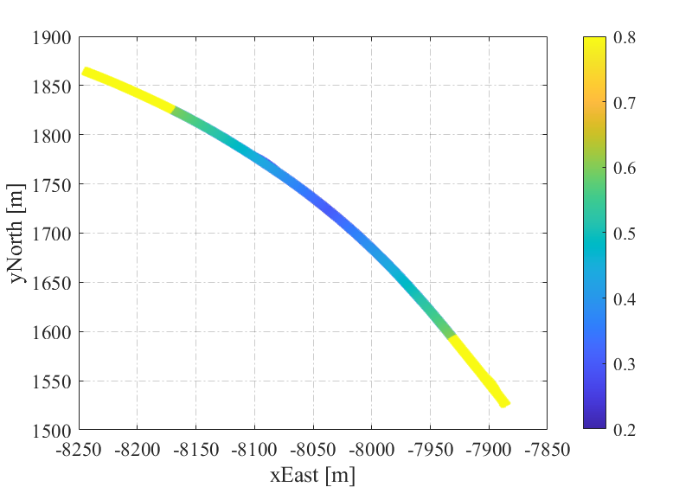
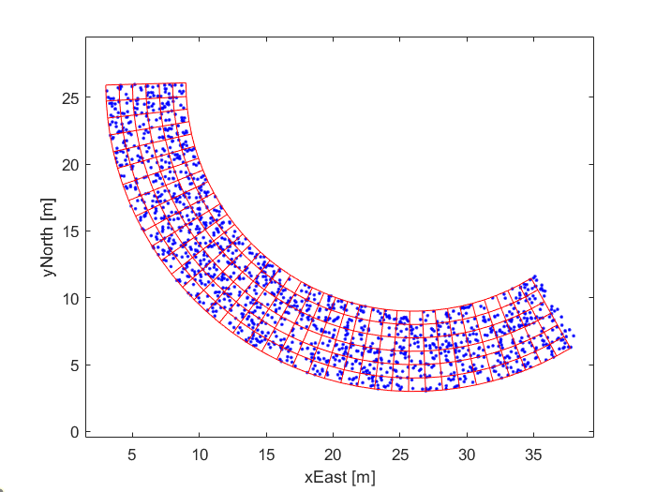
The measured raw friction data is associated with each grid cell and the friction value in each grid is represented statistical results of associated raw data.
10cm by 10cm grid size
Raw measurement data
Grid cell aggregation data
Notes:
10cm by 10cm grid size to be comparable with a tires contact patch.

Slide 12
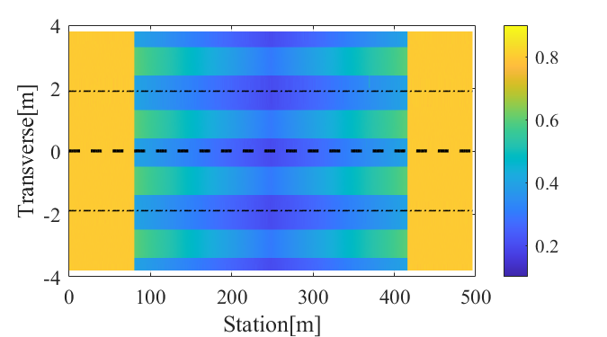
A grid-based road friction map with a high spatial resolution is generated. However, the data size of this friction map is still too large for fast sharing.
Mean friction coefficient value of each grid cell.
“True” friction distribution
Aggregate 10 million raw data into 0.4 million grids data with ~130MB storage space
root-mean-square percentage error(RMSPE): 1.31%

Slide 13
To produce a more compact representation, cells with similar friction value are clustered further.
Raw Friction Data
Notes:
The goal of this study is to generate a road friction map by aggregating the measured road-tire friction coefficients along the individual trajectories of CAVs

Slide 14
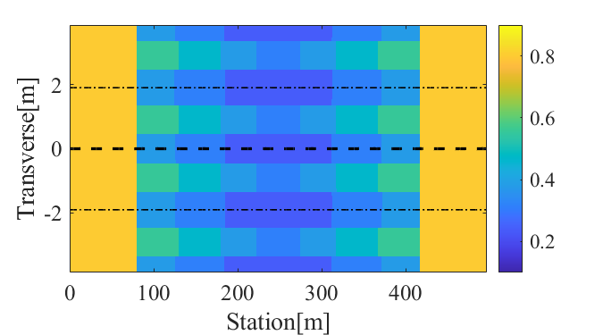
The cells with similar friction value can be grouped into clustered regions to reduce the data size. To achieve this, a spatial clustering method based on the K-Means clustering algorithm was used.
Note: The ST location values of grids are normalized into the same scale when conduct K-Means algorithm.
Notes:
Estimating the clusters number K is a major challenge of applying the K-Means algorithm. In this work, K is determined through the statistics results of friction values and expected cluster resolution. Specifically, the friction coefficient values at all grids are grouped into 10 bins at every 0.1 interval ranging from 0.1 to 0.9 (<0.1, 0.2, 0.3, 0.4, 0.5, 0.6, 0.7, 0.8, >0.9), which is shown in Figure 6(a). The number of clusters, K, was chosen to be the number of bins whose percentage is larger than 1%. From the plot, K is equal to 6 in this case. Next, the K-Means clustering algorithm is used to group the friction grids, i.e. partition the road surface.
Because clustering seeks to maintain both constant spatial coordinates and constant friction values, it is important that the scaling of spatial information is similar to friction information. In particular, the ST location values of grids are normalized into the same scale (0 to 1) and a large weight (30) is assigned to the friction attribute (on a scale of 0 to 1) when creating each cluster. The clustering result is shown in Figure 6(b). It reveals that the friction grids are clustered into friction blocks and the friction value of the grid within each block is nearly identical.
Comparing the clustering results with the true friction distribution shown in Figure 2 (d), one can see that the boundaries between the snowy bridge and adjacent dry road and the edges between snow rut and loose snow are mapped clearly. Quantitatively, the root-mean-square error (RMSE) between this clustered friction map and the true friction distribution is 0.0180, the root-mean-square percentage error RMSPE is 5.36%, and the maximum absolute error (MAE) is 0.0453, which implies an accurate mapping. It should be noted that the interval and thereby the K can be tailored to get specific cluster results, which is further discussed in section 4.1.

Slide 15
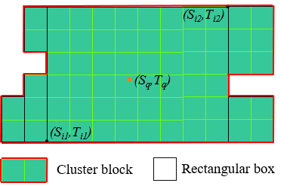
To represent friction regions efficiently, they are further partitioned into a collection of friction axis-aligned bounding boxes(AABB).
Cluster region
Bounding boxes
A partition example for one friction cluster region
Notes:
Represent the friction cluster regions with rectangular boxes, he road friction map is represented as a set of axis-aligned bounding boxes with associated friction coefficient values.

Slide 16
The road surface friction map can be represented compactly as the partition of AABB with associated friction coefficient values.
Aggregate 10 million raw data into 104 friction boxes with ~30KB of storage space
root-mean-square percentage error(RMSPE): 5.36%
Notes:
Represent the friction cluster regions with rectangular boxes, he road friction map is represented as a set of axis-aligned bounding boxes with associated friction coefficient values.

Slide 17
There is a trade-off between the partition granularity, i.e. the number of friction boxes, and mapping accuracy.

Slide 18
This paper presents a road friction map generation strategy by aggerating the measured road-tire friction coefficients from a fleet of CAVs.
We developed global road friction map generation strategy based on CAVs.
The road surface condition map can be represented compactly as the partition of axis-aligned rectangular boxes with associated friction coefficient values.
This road friction mapping strategy provides great potential for improving CAVs' control performance and stability via database-mediated feedback systems.
Thank you!
Please contact, Liming Gao, if you have further questions. LUG358@psu.edu
Notes:
In summary, in this paper, we
That’s all of my presentations. Any questions?

Slide 19
Acknowledgment
This material is based upon work supported by the National Science Foundation under grant no. CNS-1932509 CNS-1931927, CNS-1932138 “CPS: Medium: Collaborative Research: Automated Discovery of Data Validity for Safety-Critical Feedback Control in a Population of Connected Vehicles”.
Dr. Sean Brennan
Dr. Craig Beal
Notes:
I gratefully acknowledge the support for our research work from NSF and RSS 2022.

Slide 20
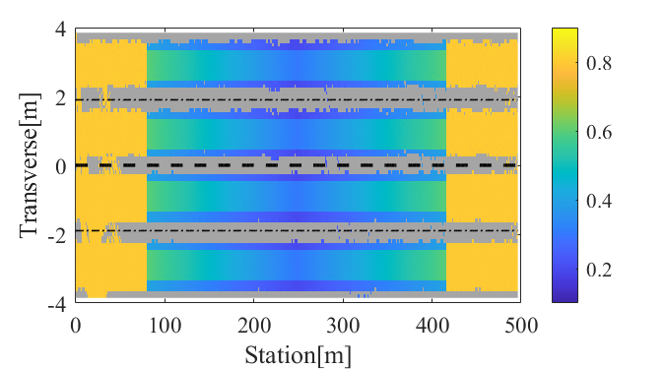
A grid-based road friction map with a high spatial resolution is generated. However, the data size of this friction map is still too large for fast sharing.
Mean of measurement data at each grid.
No measurement in grey area.
“True” friction distribution
Aggregate 10 million raw data into 0.4 million grids data

Slide 21
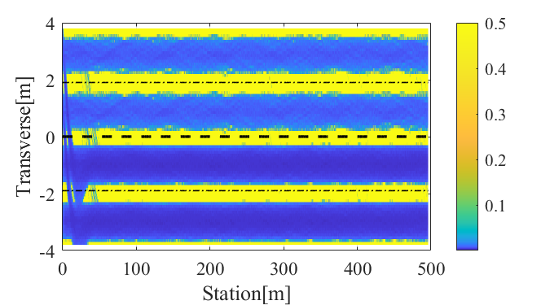
fills the friction mean value to the missing data grids using its nearest non-missing grid data, and as well fills the confidence values for missing data with the worst confidence interval to indicate high uncertainty.
After correcting for missing data, the friction map is shown here and includes: (a) the friction coefficient value of each grid cell (on a scale of 0 to 1), and (b) the confidence interval magnitude of each grid cell.

Slide 22
The drawback of representing friction maps using boundary definitions rather than AABBs is that managing the polygon object, including data storage and the spatial query, is much less efficient in a database, especially for polygons with holes. Because most databases are designed to support AABB queries, such partitions have clear implementation advantages.

